Slide 1
Microprocessors, Microcontrollers, and Embedded
Systems
CSE 315
Md. Iftekharul Islam Sakib

Slide 2
BASIC I/O in ATmega32/16

Slide 3
Ports for I/O
4 different ports for I/O
A, B, C, D
8 bit <-> 8 data pins
Every pin is bidirectional, can be used as input or output

Slide 4
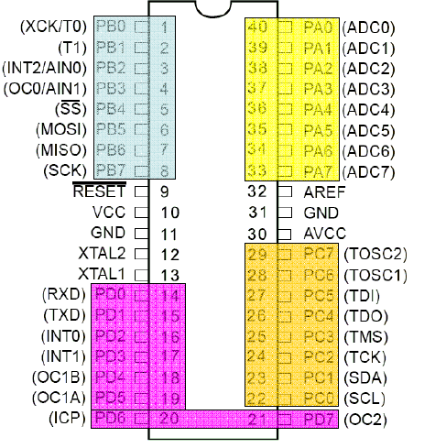
I/O Ports of ATmega32 (AVR)

Slide 5
Port Operation Registers
DDRx – Data Direction Register
PORTx – Pin Output Register
PINx – Pin Input Register

Slide 6
Configuration
For configuration we have to use the Data Direction Registers
One register for each port
DDRx (DDRA, DDRB, DDRC, DDRD)
Configures each pin as input or output
Pin configuration
Input – 0
Output – 1

Slide 7
C Code Example
DDRA = 0b11111111;
Sets each bit of port A as output
DDRB = 0b00000000;
Sets each bit of port B as input
DDRC = 0b01010101;
???

Slide 8
Input
You have to read the PINx register
unsigned char ch; ch = PINA;
What to do if only some of the pins are configured as input ??

Slide 9
Output
You have to use the PORTx register
PORTB = 0b11111111;
What to do if only some of the pins are configured as output ??

Slide 10
Write a simple program to set the port B to 0xFF

Slide 11
C Code
#include <avr/io.h>
int main(void)
{
DDRD= 0b11111111; //initializing portD in //output mode
PORTD=0b11111111;//writing value to portD
while(1)
{
//TODO:: Nothing
}
}

Slide 12
What will this code do ??
#include <avr/io.h>
int main(void)
{
DDRD= 0b01111111;
PORTD=0b11111111;
while(1)
{
//TODO:: Nothing
}
}

Slide 13
Write a simple program to blink a LED on port B pin 0

Slide 14
C Code
#include <avr/io.h>
int main(void)
{
unsigned char c = 1;
DDRB= 0b00000001;
while(1)
{
PORTB = c;
if(c)c=0;
else c=1;
delay();
}
}
void delay()
{
unsigned char i,j,k;
for(i=0;i<255;i++)
for(j=0;j<255;j++)
for(k=0;k<100;k++);
}

Slide 15
Write a simple program to animate 8 LEDs connected to PORT B
One LED at a time is ON
The rest are off
At first LED 0 is on, then LED 1, and so on.

Slide 16
C Code
int main(void)
{
unsigned char c = 0x01;
DDRB= 0xFF;
while(1)
{
PORTB = c ;
if(c==1<<7)c = 1;
else c = c << 1;
delay();
}
}

Slide 17
Accurately Generating Delay
#include <avr/io.h>
#define F_CPU 1000000 // Clock Frequency
#include <util/delay.h>
int main(void)
{
while(1)
{
//1000 ms delay
_delay_ms(1000);
}
}

Slide 18
Simple Input
A 8 bit input is connected to PORT A
Show the input state on PORT B

Slide 19
C Code
int main(void)
{
unsigned char c;
DDRA = 0x00;
DDRB = 0xFF;
while(1)
{
c = PINA;
PORTB = c ;
}
}

Slide 20
Simple Counter
PA0 is connected with push button
1 when pressed
PORT B connected to 8 LEDs
Increment count when pressed the push button

Slide 21
C Code
int main(void)
{
unsigned char c=0,in=0;
DDRA = 0xFE;
DDRB = 0xFF;
while(1)
{
PORTB = c;
in = PINA;
if(in)
{
c++;
_delay_ms(1000);
}
}
}

Slide 22

C Code
int main(void)
{
unsigned char c=0,in=0;
DDRA = 0xFE;
DDRB = 0xFF;
while(1)
{
PORTB = c;
in = PINA;
if(in)
{
c++;
_delay_ms(1000);
}
}
}
There is still a problem in the design.

Slide 23
C Code
int main(void)
{
unsigned char c=0,in=0;
DDRA = 0xFE;
DDRB = 0xFF;
PORTB = c;
while(1)
{
in = PINA;
if(in & 0x01)
{
c++;
PORTB = c;
_delay_ms(1000);
}
}
}

Slide 24
Write a program to read a byte from PORT A and write it to PORT B

Slide 25
If input (taken from PORTC) is less than 100, send it to PORTB, otherwise, send it to PORTD

Slide 26
Write a program to read a byte from PORT A and write its upper nibble to PORT B (lower nibble) and lower nibble to PORT C (upper nibble)

Slide 27
Discussions on push buttons
This might seem like the reasonable connection
what is wrong with it ??
to microcontroller
a

Slide 28
Discussions on push buttons
This might seem like the reasonable connection
what is wrong with it ??
What is the voltage at terminal a when the button is not pressed?
to microcontroller
a

Slide 29
Pull Up Resistors
+5 V
to microcontroller
a

Slide 30
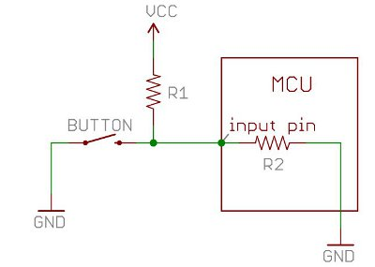
A more deeper look

Slide 31
A more deeper look
When the button is pressed, the input pin is pulled low. The value of resistor R1 controls how much current we want to flow from VCC, through the button, and then to ground.

Slide 32
A more deeper look
When the button is not pressed, the input pin is pulled high. The value of the pull-up resistor controls the voltage on the input pin.

Slide 33
A more deeper look
Because of the two opposing factors the resistor value cannot be too high not too less
Depending on the context you choose an appropriate value

Slide 34
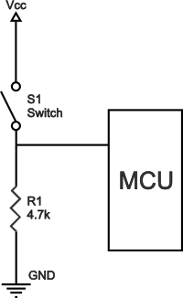
Pull Down Resistor

Slide 35
ATmega 32 has internal pull up resistors!!
If PORTxn is written logic one when the pin is configured as an input pin, the pull-up resistor is
activated.
Here, x = A,B,C, or D
n is bit number, e.g., 0,1,2,..., or 7

Slide 36
General Discussion
If some pins are unused, it is recommended to ensure that these pins have a defined level.
The simplest method to ensure a defined level of an unused pin, is to enable the internal pullup.

Slide 37
Resources
DataSheet
Pull Up and Pull Down Resistors
http://www.resistorguide.com/pull-up-resistor_pull-down-resistor/
More on Pull Up and Pull Down resistors
https://learn.sparkfun.com/tutorials/pull-up-resistors

Slide 38
☺

